Slide 1
UNIVERSITI TEKNOLOGI MALAYSIA · FACULTY OF COMPUTING · SCSE2243 · SECTION 01
UTM Borrow
A campus-wide circular resource-sharing platform —
where every handover is cryptographically signed.
Mohammed Mohsen Mohammed Alsakkaf
A23CS4026
Transaction & Handover
Muaz Ibne Ahmed
A23CS4062
Resource Catalog & Discovery
Ahmat Mahamat Mourdji Moustapha
A24CS4053
Identity & User Management
SUPERVISED BY
Dr. Mohd Yazid Bin Idris
Group Alpha
Notes:
[0:00 – 0:14] INTRODUCTION
"Good morning. We are Group Alpha — Mohammed Alsakkaf, Muaz Ibne Ahmed, and Ahmat Mahamat. Our application is UTM Borrow: a campus-wide circular resource-sharing platform, where every handover is cryptographically signed."
Delivery: All three of you on camera, or a static slide with one voice. Whoever speaks, say all three names.

Slide 2
N
Buy once. Use once. Throw away.
NEED
UTM courses require specialised, single-use items —
lab coats · calculators · drawing sets · formal attire
They lose all value after one semester, and sit unused in dorm rooms until they are thrown away.
THE ONLY CHANNEL THAT EXISTS TODAY
An unverified WhatsApp
or Telegram group
No identity
No reputation
No record of who holds what
So lenders are afraid to lend — and nothing circulates.
Notes:
[0:14 – 0:36] NEED — the problem
"Every semester, UTM students buy specialised items they use once — lab coats, calculators, drawing sets, formal attire. After one semester, they're worthless. The only place to pass them on is an unverified WhatsApp group. No identity. No reputation. No record of who holds what. So lenders are afraid to lend — and nothing circulates."
Delivery: Slow. This is the emotional beat. Let the last sentence land before you click.

Slide 3
N
We asked 29 UTM students. They confirmed it.
OUR OWN QUESTIONNAIRE
NEED
62.1%
37.9%
31%
24.1%
spend RM50–RM150 a year on items used for one semester
fear most that a lent item never comes back
have no proof at all if an item returns damaged
never find anyone willing to lend to them
29 students · multiple faculties · multiple years of study
The demand is there. The infrastructure was not.
Notes:
[0:36 – 0:54] NEED — the evidence
"We surveyed twenty-nine UTM students. Sixty-two per cent spend up to a hundred and fifty ringgit a year on items used once. Thirty-eight per cent fear never getting a lent item back. The demand is there. The infrastructure was not."
Delivery: Let each number appear as you say it — set the four boxes to Appear, On Click. The slide shows two more statistics than you speak; that is deliberate, let the eye find them.

Slide 4
A
Three subsystems. Nine modules. One verified session.
3 OWNERS
APPROACH
Identity &
User Management
Resource Catalog
& Discovery
Transaction
& Handover
Ahmat Mahamat Mourdji Moustapha
Muaz Ibne Ahmed
Mohammed Mohsen Mohammed Alsakkaf
Authentication
Item Listing & Management
Request & Approval Workflow
Profile & Trust Score
Category & Condition Metadata
QR Verification
Activity Dashboard
Location-Based Filter
Moderation & Reporting
Only @utm.my addresses may register.
A 5-star Trust Score is earned from
completed loans — never claimed.
Server-enforced category and condition.
Filter by residential college and faculty,
sort by true campus distance.
A request atomically locks the item.
Every state change is appended to
an immutable audit log.
Notes:
[0:54 – 1:15] APPROACH — architecture
"We built three subsystems, one each. Ahmat built Identity — only UTM emails may register, and the Trust Score is earned, never claimed. Muaz built the Catalog, with server-enforced categories and college filtering. I built Transaction and Handover, where a request locks the item and every state change is logged."
Delivery: Name each owner out loud. The rubric rewards visible individual contribution.

Slide 5
A
A loan cannot skip a state.
THE ACCOUNTABILITY ENGINE
APPROACH
Available
›
Pending
›
Approved
›
Borrowed
›
Completed
Listed in the catalog
Request locks the item atomically
Lender accepts after the Trust Score
Lender scans the signed QR
Return scan closes it; both rate
PROOF OF PHYSICAL HANDOVER
A captured code cannot be replayed.
A handover cannot be quietly undone.
Every scan attempt is logged — success,
expired, wrong transaction, already used.
UTMB . <payload> . <signature>
HMAC-SHA256, signed with a server-held secret.
Re-verified on every scan. Expires in 24 hours.
Notes:
[1:15 – 1:35] APPROACH — the mechanism
"A loan is a state machine — Available, Pending, Approved, Borrowed, Completed. It cannot skip a state. The handover itself is proven with a signed token: HMAC-SHA256, re-verified on every scan, expiring in twenty-four hours. A captured code cannot be replayed. A handover cannot be quietly undone."
Delivery: This is the technical heart of the project. Say it with confidence, not speed.

Slide 6
APPROACH · LIVE SYSTEM
It is not a mockup. It is deployed.
React · FastAPI · MongoDB — live on Vercel and Render at utmborrow.alsakkaf.site
Notes:
[1:35 – 2:08] APPROACH — LIVE DEMO
"Here it is running. A student filters the catalog by residential college, opens an item, and sends a borrow request. The item locks immediately, so nobody else can claim it. The lender reviews the borrower's Trust Score and approves. They meet. The borrower shows the QR code; the lender scans it — and only then does the item become Borrowed. When it comes back, a second scan closes the loan, and both students rate each other."
Delivery: Hold the card ~3 seconds, then CUT TO SCREEN RECORDING. See the demo shot list below.
DEMO SHOT LIST — record at 1920x1080 from https://utmborrow.alsakkaf.site/login
1. Browse the catalog. Apply a college filter. (~5s)
2. Open an item, pick dates, send a request -> Pending. (~7s)
3. Switch to the lender. Approve. (~5s)
4. Borrower shows QR. Lender scans. -> Borrowed. (~9s)
5. Return scan. -> Completed. Rating dialog opens. (~7s)
Use two browsers side by side so the handover is believable.

Slide 7
A
Built on a real, deployed stack.
AS BUILT, NOT AS PLANNED
APPROACH
PRESENTATION
React 18 · Tailwind CSS · Framer Motion · Axios
One single-page app for desktop and mobile. Hosted on Vercel.
27/27
APPLICATION
FastAPI · Python 3.12 · uvicorn
Authentication, validation, the state machine, QR signing, moderation. Hosted on Render.
use cases fully implemented — each with a working endpoint, its database collections, and the matching screen, all wired together and live.
DATA
MongoDB · Motor async driver · 11 collections
Users, items, transactions, state logs, QR tokens, scan events, reports, audit.
Security is not a diagram: bcrypt hashing · JWT sessions · HMAC-SHA256 handover tokens · TOTP two-factor on every admin action
Notes:
[2:08 – 2:21] APPROACH — technology
"React on Vercel, FastAPI on Render, MongoDB behind it. All twenty-seven use cases implemented. Security is not a diagram: bcrypt, JWTs, signed tokens, and two-factor on every admin action."
Delivery: Brisk. This slide is proof, not persuasion. If the video runs long, trim here — never the demo.

Slide 8
B
What the community gets.
BORROWERS · LENDERS · THE UNIVERSITY
BENEFIT
Borrowers stop buying
Lenders lend without fear
The university keeps control
The RM50–RM150 a student spends each year stays in their pocket. Items are found by college and faculty — collection is a walk, not a trip.
The counterpart is a verified UTM member with an earned Trust Score. If there is a dispute, there is cryptographic proof of both the handover and the return.
The email gate keeps non-affiliates out of campus trade. Moderation is two-factor gated and every decision is permanently audited.
Every item borrowed instead of bought is one fewer purchased, and one fewer discarded.
The platform turns that into reportable data for UTM's Smart & Green Campus agenda and UN SDG 12 — Responsible Consumption and Production.
Notes:
[2:21 – 2:43] BENEFIT
"Borrowers stop buying — that money stays in their pocket. Lenders lend without fear: the counterpart is verified, and there is proof of both handover and return. The university keeps outsiders out, every decision audited. Every item borrowed is one fewer bought and one fewer discarded — UTM's Smart and Green Campus, and SDG 12."
Delivery: Three beats, one per column. Pause between them.

Slide 9
C
Nobody else can prove a handover happened.
UNIQUENESS
COMPETITION
Capability | WhatsApp & Telegram groups | Marketplace apps | Faculty / library loan counter | UTM BORROW
Restricted to verified UTM members | — | — | ● | ●
Reputation earned from completed loans | — | ○ | — | ●
Cryptographic proof of handover | — | — | ○ | ●
Cryptographic proof of return | — | — | ○ | ●
Student-owned items · no fee, no deposit | ● | — | — | ●
● fully supported ○ partial or informal — absent Marketplace apps sell; loan counters lend only what the university already owns.
Not one existing channel can prove that a physical handover actually happened. UTM Borrow can.
Notes:
[2:43 – 2:57] COMPETITION
"A WhatsApp group verifies nothing. Marketplace apps are built to sell, and let outsiders in. The loan counter only lends what the university owns. None of them can prove a handover happened. UTM Borrow can."
Delivery: On the last sentence, point at the final column.

Slide 10
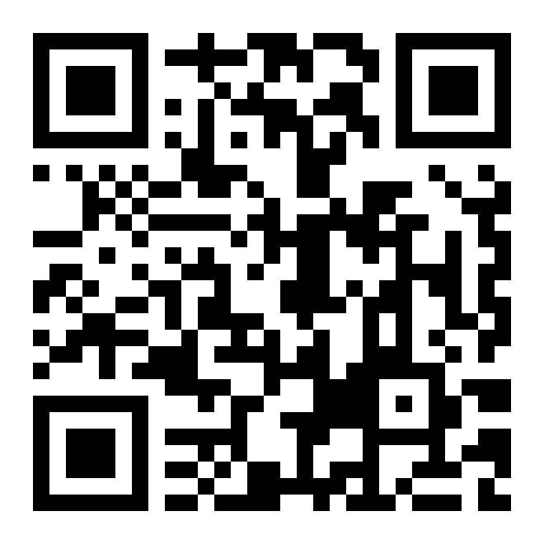
Every handover,
signed.
27 of 27 use cases · 3 subsystems · 9 modules · live and deployed
Scan to open the live app
utmborrow.alsakkaf.site
github.com/Alsakkaf-dev/UTMBorrow
Group Alpha · Faculty of Computing, Universiti Teknologi Malaysia · Semester II 2025/2026
Notes:
[2:57 – 3:00] CLOSE
"UTM Borrow. Every handover, signed. Thank you."
Delivery: Hold the QR on screen for the final two seconds. Do not rush the last word.

